Slide 1
OOMF (Output Outcome Monitoring Framework) Dashboard
Introduction

Slide 2
Contents
1. OOMF : Background
2. How to use OOMF Dashboard
3. OOMF Dashboard : Other capabilities

Slide 3
OOMF: Background
01

Slide 4
Output Outcome Monitoring Framework (OOMF) Background & Timeline
A step towards outcome-based budgeting
May 2016
Dec 2016
Feb 2017
July 2018
July 2019
Feb 2020
June 2020
Feb 2021
Output Outcome Monitoring Framework 2017-18 submitted by NITI Aayog to DoE
DMEO developed a dashboard for monitoring of 68 M/Ds; Training workshops organised
Output Outcome Monitoring Framework 2020-21 presented in the Parliament
Output Outcome Monitoring Framework 2021-22 presented in the Parliament
Letter from Secretary, DoE to Ministries to prepare measurable outcomes for CS/CSS
Output Outcome Monitoring Framework 2017-18 approved by the Parliament
Output Outcome Monitoring Framework 2019-20 presented in Parliament
M/D wise OOMF Review meetings under chairmanship of Hon’ble Members of NITI initiated

Slide 5
Output Outcome Monitoring Framework (OOMF) Principles & Activities
The goal of OOMF framework is to help improve outcomes & impacts
Stronger portfolio of schemes creates greater impact
Scale-up performing schemes & close down non-performing schemes
Identify performing & non-performing schemes
Monitor Outcomes of Schemes
Define Measurable Outcomes
Evaluation & Appraisal
Review & Redesign
Activities
Monitoring
DMEO, in joint discussions with ministries / depts, defines OUTCOMES using proposed framework
Department of Expenditure with support from NITI, Ministries/Departments, and others

Slide 6
Output Outcome Monitoring Framework (OOMF) Framework
OOMF Tool has been built based on international best practices
Relevant and measurable outputs, outcomes, and indicators
Indicators and Targets are approved from respective secretaries of Ministries / Departments
Monitored through a dashboard shared across 67 Ministries/Departments
Results of Activities
Objectives of Schemes
Scheme
( CS / CSS )
Outlay
Outputs
Outcomes
Measurable Targets

Slide 7
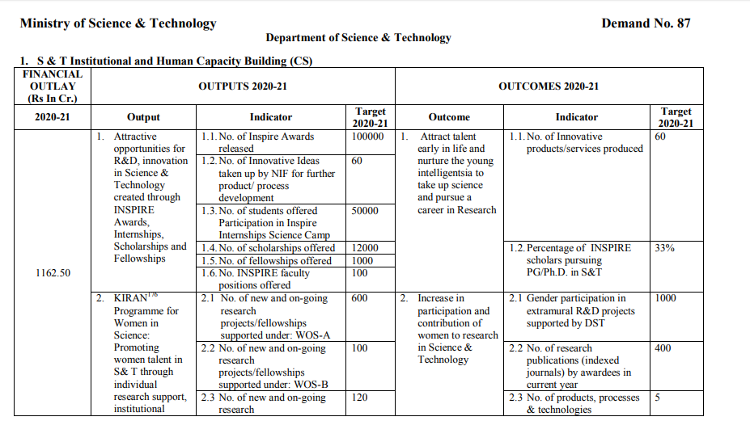
Output Outcome Monitoring Framework (OOMF) Sample
Snapshot of a Sample Scheme for DST
Ministry / Department
Demand
Number
Scheme-wise OOMF Assessment
Well defined Outcomes
Measurable Indicators
Allocated Financial Outlay
Quantified Targets
Well defined Outputs
Measurable Indicators
Quantified Targets

Slide 8
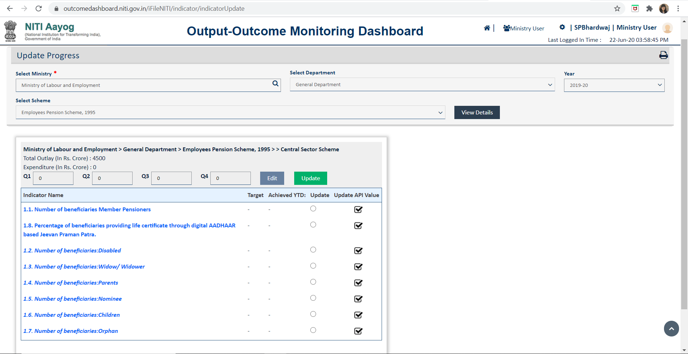
Output Outcome Monitoring Framework (OOMF) Ministry / Department Level Dashboard
DMEO maintains the Output Outcome Monitoring Dashboard to track the performance of CS/CSS outlays
Dedicated credentials have been created for the 67 Ministries/Departments to update the progress against the Output (mostly quarterly) and the Outcome (mostly annually) indicators
Creation of credentials for Ministries/Department
DMEO team updates indicators and targets according to latest budget
Quarterly reporting of progress data by M/D on dashboard
Reporting module added for generation of reports

Slide 9
How to use OOMF Dashboard
02

Slide 10
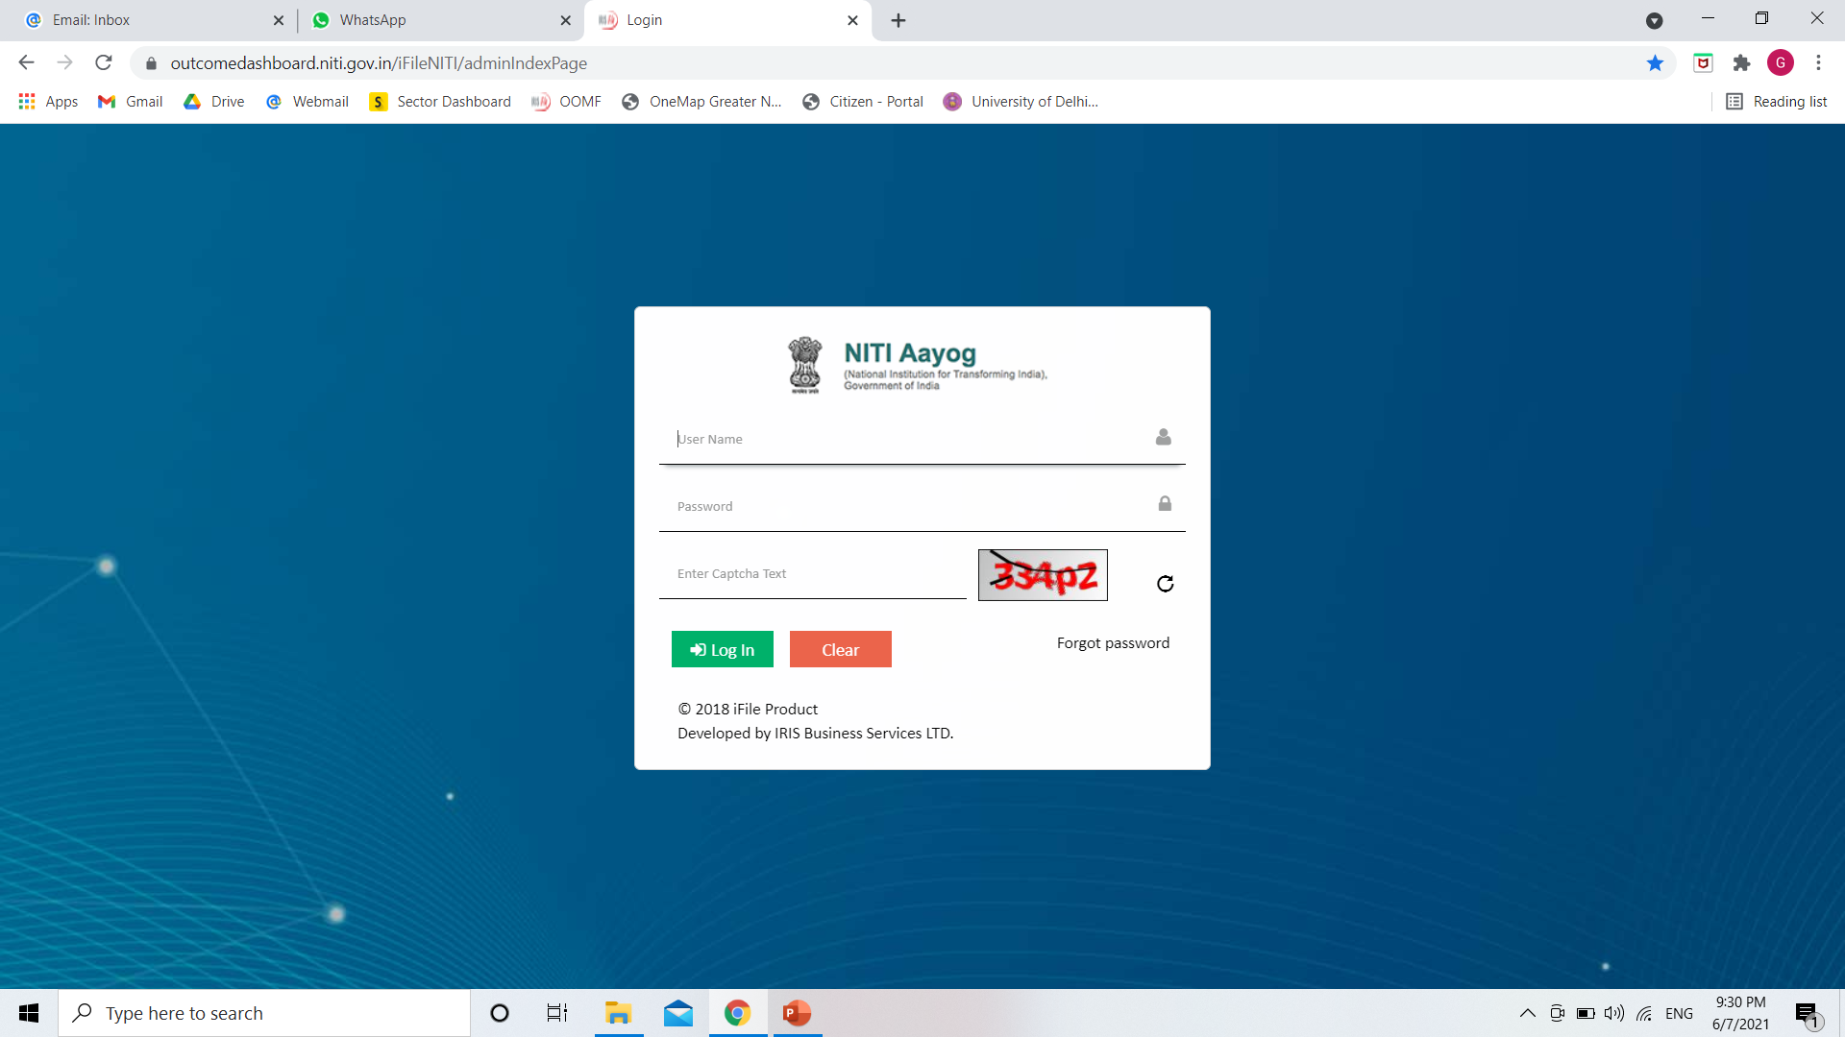
Login at outcomedashboard.niti.gov.in

Slide 11
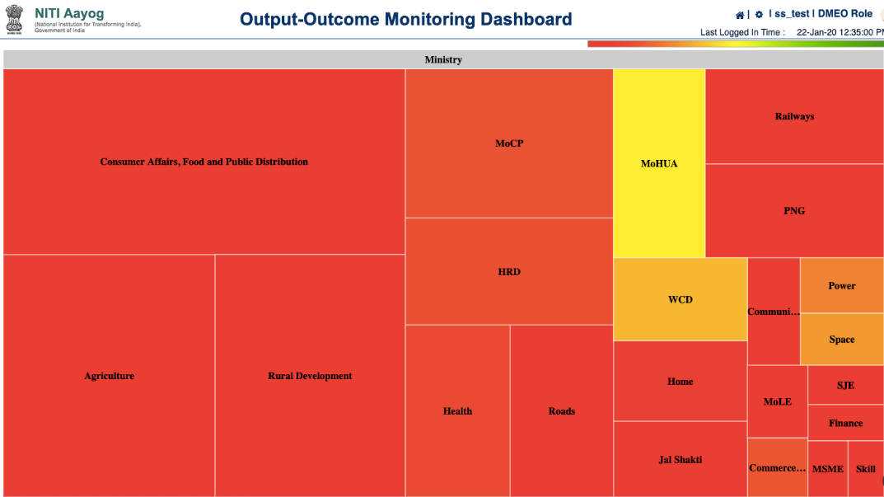
Output Outcome Monitoring Dashboard Heat Map on Landing Page
Overall view at the landing page with special emphasis on higher outlays : The landing page of the dashboard gives an overall view of the performance of the Ministries with outlay >5,000 Crores. The size of the box here corresponds to the total outlay of the Ministry.
Performance Indication: The color coding is according to the performance of the Ministry w.r.t to the performance on the indicators.
Red color - Achievement <=50%,
Yellow/Orange - Achievement between > 50 & less than or equal to 75 %
Green - Achievement greater than 75 %

Slide 12
Output Outcome Monitoring Dashboard Heat Map on Landing Page – A Snapshot (1/3)
Landing Page

Slide 13
Output Outcome Monitoring Dashboard Heat Map on Landing Page – A Snapshot (2/3)
Department View: On clicking specific Ministry

Slide 14
Output Outcome Monitoring Dashboard Heat Map on Landing Page – A Snapshot (3/3)
Scheme View: On clicking specific Department

Slide 15
Updating progress on OOMF Dashboard
02a

Slide 16
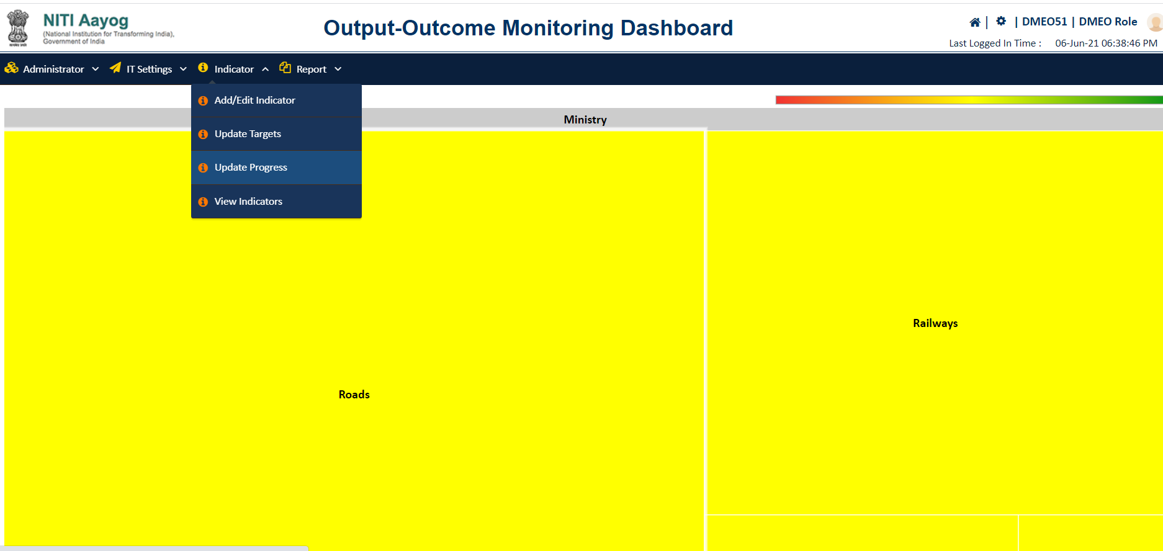
Updating progress on OOMF dashboard Main Menu(1/5)
Select ‘Update Progress’ from the menu

Slide 17
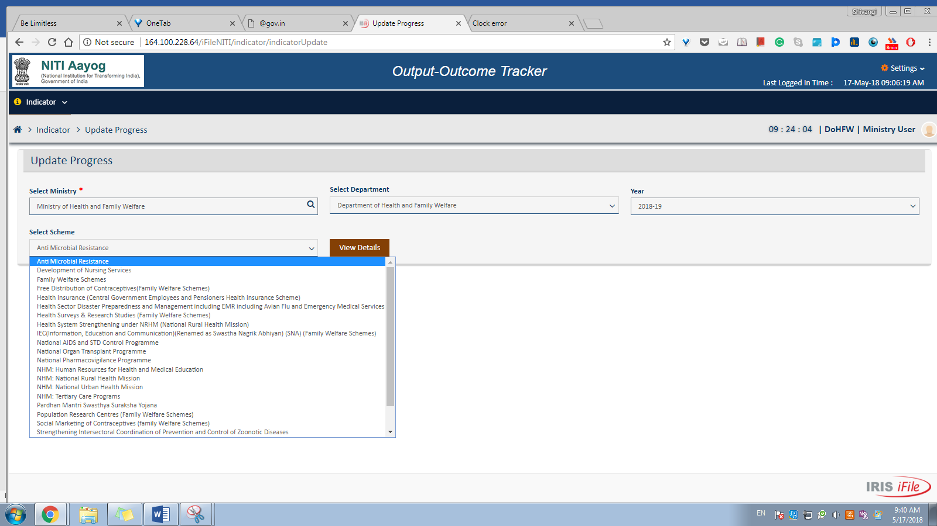
Updating progress on OOMF dashboard Selection of Ministry/Department and scheme (2/5)
Select the Ministry and Department
Select Scheme from the scheme dropdown

Slide 18
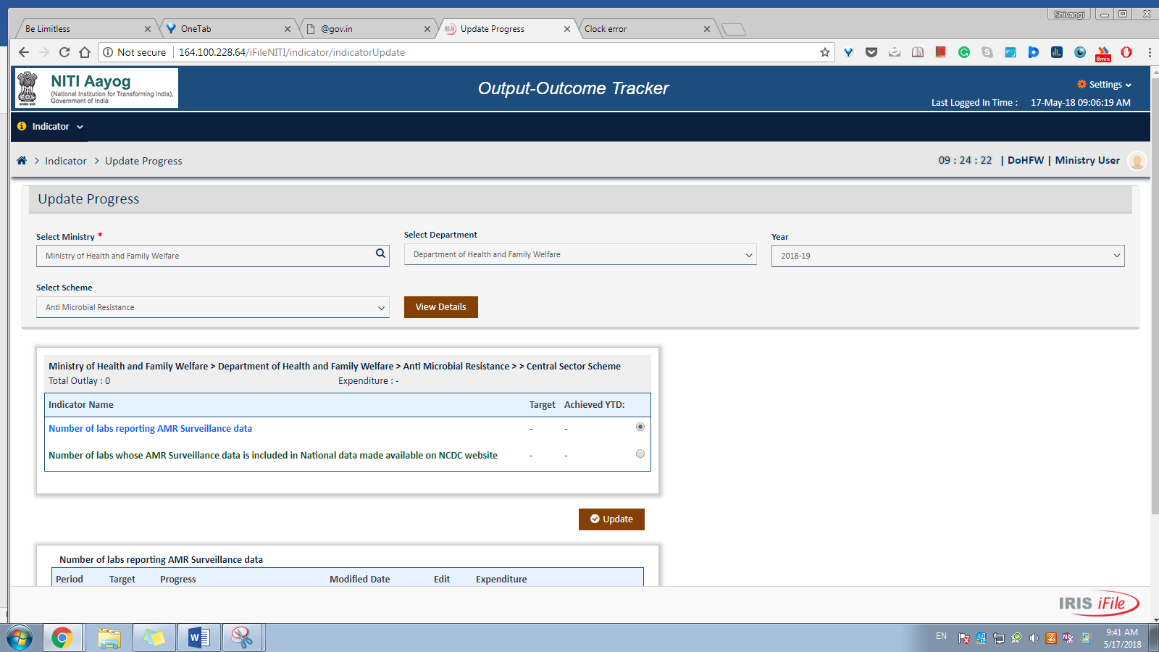
Updating progress on OOMF dashboard Selection of indicator (3/5)
Select the indicator for which progress has to be updated

Slide 19
Updating progress on OOMF dashboard Edit progress (4/5)
Click on the edit to enter the progress

Slide 20
Updating progress on OOMF dashboard Fill in progress information (5/5)
Fill in the progress data for the indicator against each quarter for outputs and annually for outcomes

Slide 21
Viewing reports on OOMF Dashboard
02b

Slide 22
Viewing reports on OOMF Dashboard
Types of reports
Reporting Module
Compliance Report
Progress Report
To provide single-point access to Ministry/Departments to review status of data reporting on the dashboard
Compliance against both target and progress updates can be reviewed
To provide single-point access to review progress/achievements of schemes against set targets, as reported by the Ministry/Departments on the dashboard

Slide 23
Viewing reports on OOMF Dashboard Compliance Report – Home Page
Summary Compliance Report
Detailed Compliance Report
Shows compliance of all indicators for a single FY
Frequency is annual
Frequency quarterly, half yearly, Annually
Single/Multi year Selection
Flexibility in scheme selection
Flexibility of indicator type selection

Slide 24
Viewing reports on OOMF Dashboard Detailed Compliance Report
CS/CSS
Single/Multiple
Single/Multiple
Output/Outcome

Slide 25
Viewing reports on OOMF Dashboard Summary Compliance Report
Single/Multiple
Single select

Slide 26
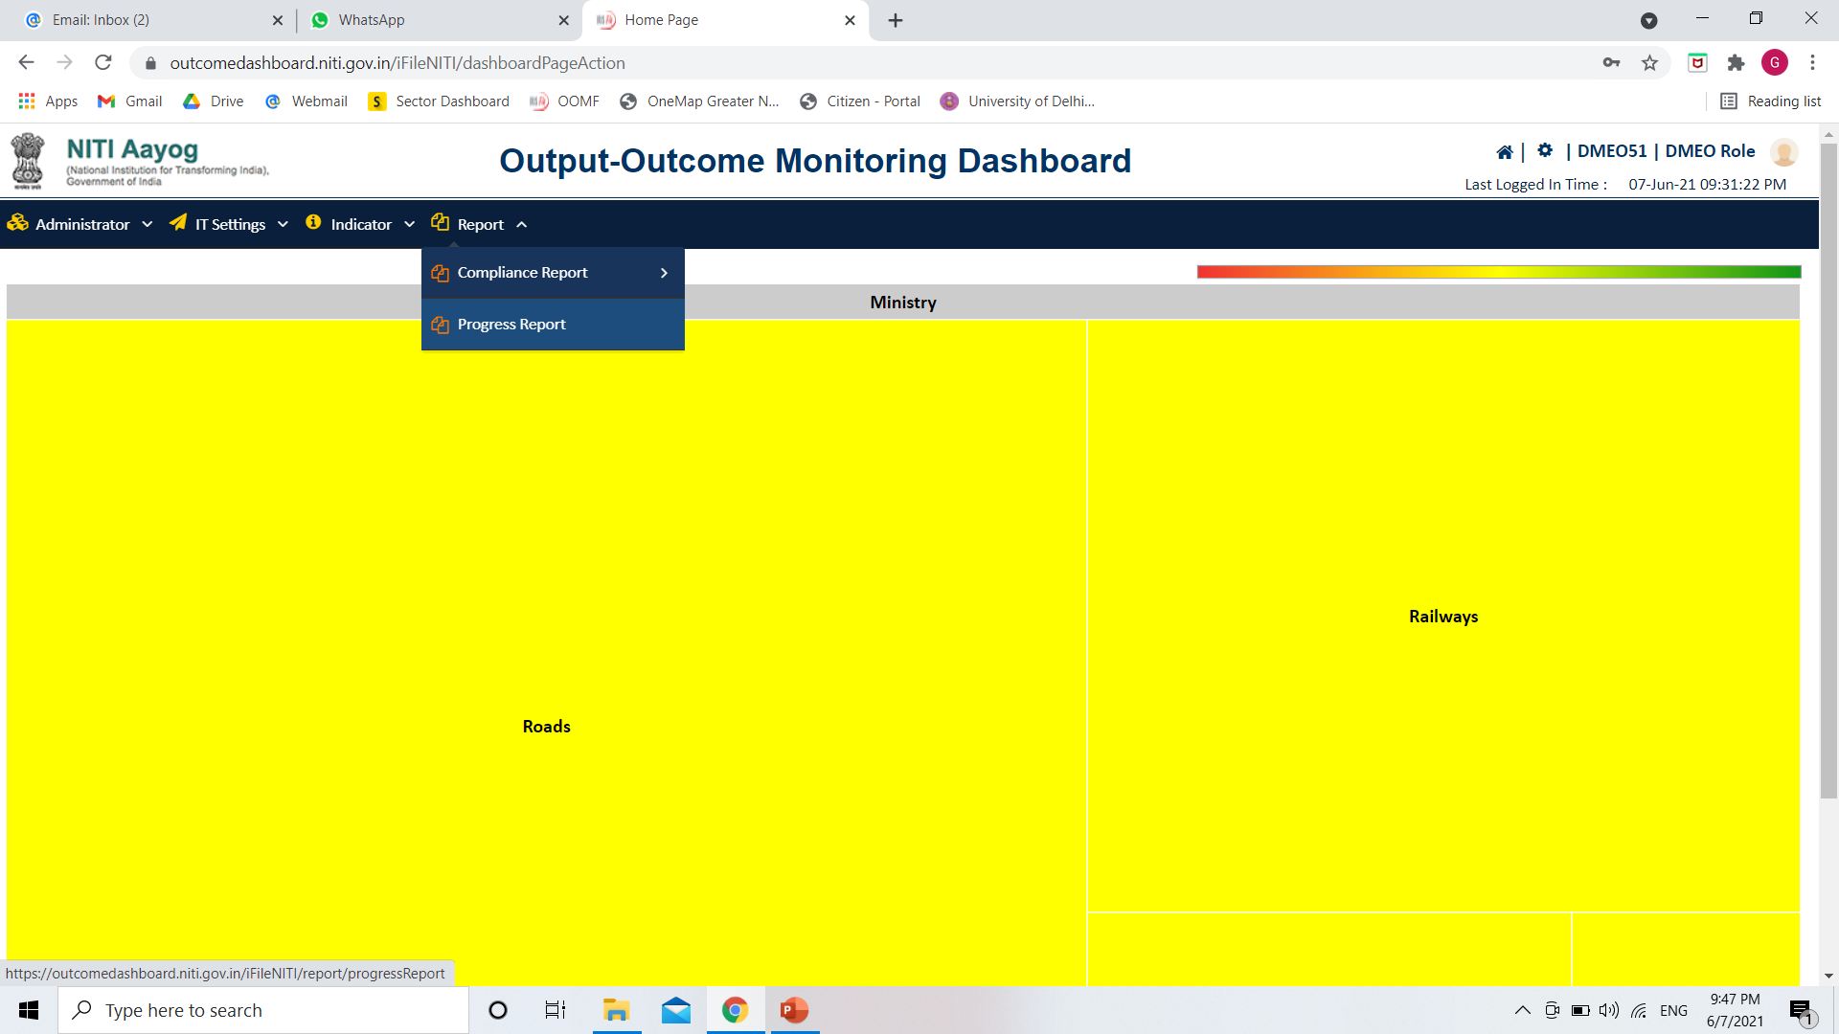
Viewing reports on OOMF Dashboard Progress Report – Home Page

Slide 27
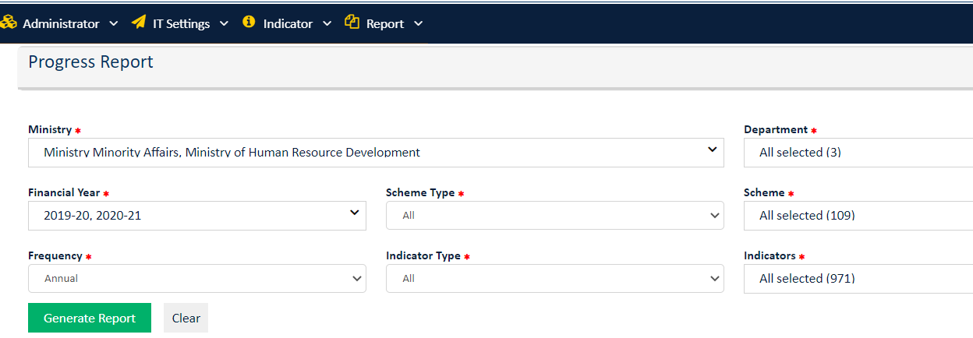
Viewing reports on OOMF Dashboard Progress Report (1/2)
CS/CSS
Single/Multiple
Single/Multiple
Single/ Multiple
Single/Multiple
Quarterly /half yearly/ Annually
Output/Outcome
Ministry wise progress of allotted ministries
Could be used to track the performance of the scheme

Slide 28
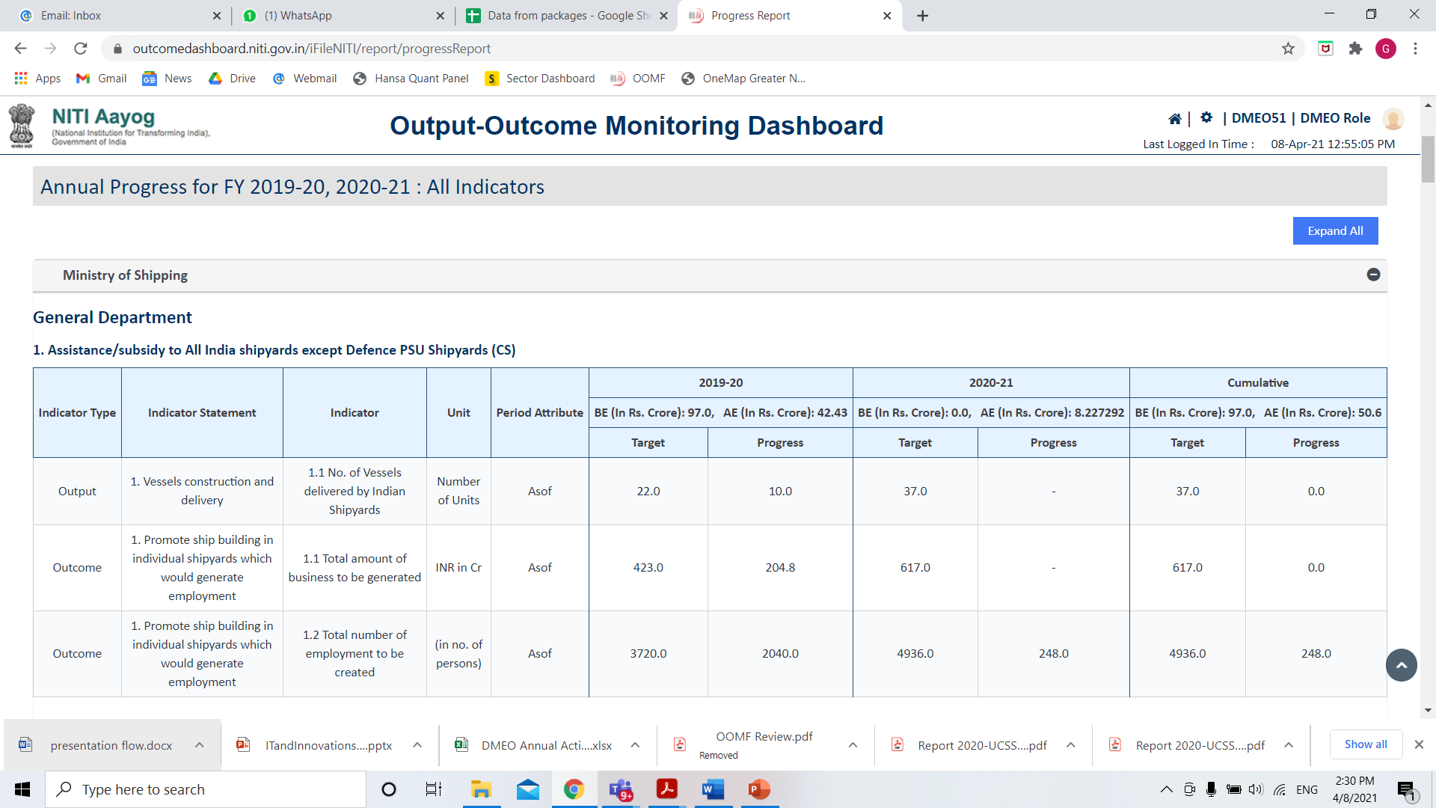
Viewing reports on OOMF Dashboard Progress Report (2/2)
Ministry Name
Department Name
Scheme Name
Available - Ministry wise, Scheme wise
Single/Multi year view
Excel / PDF download options
Useful for decision making

Slide 29
OOMF Dashboard : Other Capabilities
03

Slide 30
Output Outcome Monitoring Dashboard Other Capabilities
Multiple Graphs facilitating analysis on the performance (YoY, QoQ) of the M/Ds
Data Granularity: Provision to take district level data
MIS integration in process for automated data capture from other M/Ds’ MIS
Heat Map to give overall achievement status of the major Ministries (>5,000 Crores)
Audit trail maintained with notifications triggered on every action
Different access rights to maintain data privacy

Slide 31
Output Outcome Monitoring Dashboard View Graphs functionalities (1/2)
Bar Graph
Line Chart

Slide 32
Output Outcome Monitoring Dashboard View Graphs functionalities (2/2)
Mixed Chart
India’s heat map

Slide 33
Output Outcome Monitoring Dashboard District level data functionalities (1/2)
National View
State View

Slide 34
Output Outcome Monitoring Dashboard District level data functionalities (2/2)
Label showing target and progress data for the Balod district
District view

