Slide 1
Webinar on Data Governance Quality Index
Participants are requested to please enter following details in the chat box as soon as they enter the meeting-
Name,
Designation,
Ministry/Department
Participants are on mute by default to avoid disturbances. They are requested to be on mute during the Webinar.
If anyone wants to raise any queries during the presentation, they are requested to please type the same in the chat box.
The floor will be opened to obtain any further feedbacks / suggestions after the presentation
The Webinar will be recorded for documentation purposes

Slide 2
Data Governance Quality Index
Webinar on DGQI 2nd Edition
28th September ,2021

Slide 3
Agenda
DGQI 2nd Edition:
Background
Self-Assessment Questionnaire
Scoring Methodology
SOP for M/D and scheme exclusions requests
Timelines
FAQs

Slide 4
DGQI 2nd Edition: Background

Slide 5
Objectives
To review and assess the data preparedness of the data/ MIS systems
To prepare a self-assessment diagnostic tool – Trigger contemplation on improvements
To prepare an Index for M/Ds with a target to attain frontier DGQI score of 5/5
To document & disseminate best practices
Competitive
Cooperative
Notes:
To review and assess the data preparedness of the data/ MIS systems of the Ministries/Departments on objective parameters of a standardized framework.
To prepare a self-assessment diagnostic tool that will enable the M/Ds to internally contemplate the need for improving data systems.
To prepare a Data Governance Quality Index to drive healthy competition among the ministries/departments to learn from each other and improve MIS systems.
To document best practices to be disseminated for learning & development of the Ministries/ Departments and other governance entities.

Slide 6
Enhanced horizontal scope
Data Strategy
Data Systems
Data driven Outcomes
Focus of DGQI 2020 exercise
Other two pillars included in DGQI 2nd Edition

Slide 7
Enhanced vertical scope
All CS/ CSS schemes of M/Ds
78 M/Ds
All Schemes + Other initiatives
Non-schematic interventions of M/Ds
Non-schematic interventions can include sector-level MIS/dashboards, MIS/dashboards for PSUs/other central expenditure/any other purposes, SDG/NDA monitoring systems, e-services etc.

Slide 8
Introduction of new themes
Data Strategy
(Activities)
Data Systems
(Outputs)
Data driven Outcomes
(Outcomes)
2 new themes:
Data & Strategy Unit
Action Plan
1 new theme:
1. Data management
3 new themes:
Synergistic data use
Inter-agency data collaboration
Prescriptive analytics
14 new questions
30 existing questions +
20 new questions
9 new questions

Slide 9
DGQI 2nd Edition: Self-Assessment Questionnaire

Slide 10
DGQI 2nd Edition Questionnaire: Structure
All themes and questions mapped into two parts based on the level at which they are to be answered
Part A
To be filled at M/D level
Data & Strategy Unit (7)
Part A:
List of all CS/CSS Schemes as per Budget 2021-22 already available
Additional schemes (if any) and all non-schematic interventions to be manually added by the M/Ds
Part B:
To be filled in separately for each scheme available and non-schematic intervention added in Part A
Action Plan (7)
Data Management (5)
Synergistic data use within M/Ds (3)
Inter agency data collaboration (2)
Prescriptive Analytics (3)
Best Practices (1)
Part B
To be filled at CS/ CSS/ NSI level
Data generation (7)
Data quality (4)
Data analysis, use & dissemination (13)
Use of technology (6)
Data security & HR capacity (10)
Data management (5)

Slide 11
DGQI 2nd Edition: Scoring Methodology

Slide 12
Principles of scoring mechanism
Focus on distance-to-frontier scores rather than on rankings and comparisons to encourage all M/Ds to reach frontier DGQI 5.0 scores by December 2022
Provides two scores – Scheme-score (based on Data Systems) and Overall M/D score for driving improved intra-ministerial dialogue on reforms
Aims at driving continuous reforms by M/Ds to attain increasing data preparedness.
Considers current constraints faced by M/Ds with regards to their data systems while laying down a way forward for them to attain frontier scores by December 2022.
Pragmatic and reasonable to not penalize any scheme or M/D for small issues
Takes into account the non-applicability of certain questions/sub-questions to certain types of schemes and/or Ministries/Departments
Gives equal focus to scheme specific and M/D specific themes and parameters; and also to schemes and other types of non-schematic interventions

Slide 13
Scoring mechanism
Based on Part A of the Questionnaire
Data Strategy pillar score
Data Systems pillar score
Data driven Outcomes pillar score
DGQI score
20% Weightage
60% Weightage
20% Weightage
Based on Part B of the Questionnaire

Slide 14
Theme wise weightages – Data Strategy Pillar
Data Strategy pillar score
Data Systems pillar score
Data driven Outcomes pillar score
DGQI score
Theme | Theme weightage within data strategy pillar
Data & Strategy Unit | 50%
Action Plan | 50%
Data strategy score = 50% * (Data & Strategy Unit score) + 50% * (Action plan score)

Slide 15
Theme wise weightages – Data Systems Pillar
Data Strategy pillar score
Data Systems pillar score
Data driven Outcomes pillar score
DGQI score
Theme | Theme weightage within data systems pillar
Data Generation | 18%
Data Quality | 18%
Data analysis, use & dissemination | 18%
Use of technology | 10%
Data security & HR capacity | 18%
Data management | 18%
Data systems score for each scheme/NSI = 18% * (Data gen score) + 18% *(Data qual) + 18% * (Data analysis) + 10% * (Use of tech) + 18% *(Data sec& HR capacity) + 18% * (Data management)
Simple average of all scheme-level/NSI data systems scores to arrive at aggregated data systems score

Slide 16
Theme wise weightages – Data Outcomes Pillar
Data Strategy pillar score
Data Systems pillar score
Data driven Outcomes pillar score
DGQI score
Theme | Theme weightage within data driven outcomes pillar
Synergistic data use within M/D | 30%
Inter-agency data collaboration | 30%
Prescriptive Analytics | 10%
Good practices | 30%
Data outcomes score = 30% * (Synergistic data use score) + 30% * (Inter-agency data collab score) + 10% * (Prescriptive analytics score) + 30% * (Good practices score)

Slide 17
Summary
Pillar | Pillar Weight in DGQI | Theme | Theme weight within pillar | Overall theme weight in DGQI
Data Strategy | 20% | DSU | 50% | 10%
 |  | Action plan | 50% | 10%
Data systems | 60% | Data generation | 18% | 11%
 |  | Data quality | 18% | 11%
 |  | Data analysis, use & dissemination | 18% | 11%
 |  | Use of technology | 10% | 6%
 |  | Data security & HR capacity | 18% | 11%
 |  | Data management | 18% | 11%
Data driven outcomes | 20% | Synergistic data use within M/D | 30% | 6%
 |  | Inter-agency data collaboration | 30% | 6%
 |  | Prescriptive Analytics | 10% | 2%
 |  | Good practices | 30% | 6%

Slide 18
Special Cases
NA response:
To consider the Non-applicability of certain questions or sub-parts of questions, NA option has been included in the DGQI self-assessment questionnaire this time.
It is recommended that M/Ds use the NA option only if the question/sub-part of the question is actually not applicable to them, owing to the nature of the intervention and not simply because it is currently not being practiced.
For instance, if there is a social sector scheme targeted at improving nutrition status of school-going children but the MIS is capturing data only at district level and not at individual/facility(school) level, this does not mean that individual or facility level data reporting is not applicable. It is applicable as it is an individual-targeted scheme, however, it is currently not being practiced. Hence, the correct option to choose in such cases would be ‘No’ and not ‘NA’.

Slide 19
Scoring of Special Cases
For a certain question, if NA option is selected, its weight will be redistributed among other questions within the theme.
However, if it is the case that only certain sub-parts (a,b,….) of a question are not applicable, a case-by-case mechanism of how they will be taken care of at the scoring stage has been devised.
Example, Question: C2, Part B- Cross Sectional Analysis:
Question: Is cross-schematic/sectoral data also analysed, wherever needed?
Options: Yes, No, NA
If NA is selected by the M/D, the question weight will be redistributed within the data analysis theme.
Disabled response: If the question is disabled based on skipping patterns, it would accordingly be given appropriate score. For eg: If action plan is not formed, M/Ds would be scored zero on all other questions related to action plan that get automatically skipped.

Slide 20
SOPs

Slide 21
SOP for Scheme Exclusion/Deletion from portal
Mandate : All CS/CSS schemes to be included in DGQI 2.0.
If any Ministry/Department wants to exclude any scheme from DGQI, they must put up a formal request in the form of a letter to DMEO
The letter must contain the scheme names along with the rationale for their exclusion.
The response will be shared with the Ministry/Department within two working days of receiving the exemption request.
If the M/D wants a full exemption from DGQI exercise, the exemption request should be made directly to PMO, while copying DMEO.
As the timeline for 30th Sept is very close, request all M/Ds to share exemption requests by today EoD positively, after which immediate exemption may not be possible.

Slide 22
Timelines

Slide 23
Timelines
Milestone | Timeline
Last Review with Adviser to PM, Sh. Bhaskar Khulbe | 14th July 2021
Link to the dashboard, credentials and training videos shared with M/Ds along with launch of the dashboard | 31st August to 01st Sept
Training for M/Ds on DGQI portal and questionnaire | 8th Sept
M/Ds to complete filling up the questionnaire | 30th Sept
DGQI scores based on information filled in portal to be released | Oct
DMEO Comments on action plans shared by M/Ds | Oct
Quarterly Review meetings (Q1 and Q2 combined review) with PMO (M/Ds to be clubbed on the basis of performance) | Oct – Nov
M/Ds to finalize their action plan after incorporating DMEO comments | Oct - Nov
DGQI 2.0 portal launch by PM with latest data from all the M/Ds | 25th Dec
Quarter 3 progress update to be made by M/Ds | Jan, 2022

Slide 24
FAQs

Slide 25
FAQ on DGQI Portal
What should the M/D do if drafts are not being saved in the portal?
M/D may contact the local NIC team to resolve the issue. If the issue still persists, the M/D to write an email to the DMEO nodal mapped to them, with the screenshot of the issue being faced.
What should the M/D do if the information saved does not reflect on the portal when they login later?
M/D may contact the local NIC team to resolve the issue. If the issue still persists, the M/D to write an email to the DMEO nodal mapped to them, with the screenshot of the issue being faced.
What should the M/D do if duplication of schemes result in multiple schemes of same name in the portal?
M/D to share an email with the DGQI DMEO Nodal mapped to the M/D with a screenshot showing the duplicated schemes and share the list of schemes that need to be deleted from the list.
What if the M/D wants exclusion of schemes from the DGQI exercise and wants those schemes removed from the dashboard?
M/D to send a D.O Letter to DG, DMEO detailing the rationale behind excluding the schemes from DGQI exercise. DMEO would consider the request and respond within two working days. Please note that in this case, the exclusion is sought for schemes and not the M/D as a whole. M/D wise exemptions should be sought directly from PMO.

Slide 26
FAQ on questionnaire
Please explain about DGQI 2.0 self-assessment questionnaire and how is the same to be responded to with regards to CS/CSS/NSI?
DGQI 2.0 self assessment questionnaire has two main parts : Part A (to be filled at M/D level) and Part B (to be filled at scheme/NSI level - for each CS/CSS scheme/NSI). Hence, Part A is to be filled only once by each M/D. However, each M/D has to fill up as many Part Bs as they have CS/CSS/NSI.
What is Prescriptive Analysis?
Prescriptive analytics is the final stage of analytical capabilities. While predictive analytics answers what, when and why something will happen, prescriptive analytics builds on this further by specifying what present actions need to be undertaken to achieve the predictions and how will these decisions affect /impact other outcomes. Therefore, it helps in taking advantage of a future opportunity or mitigating future risks. It can also improve the accuracy of predictions by continuously taking in new data to re-predict and re-prescribe.
For example, if a credit agency uses modelling algorithms to predict the risk of default by borrowing companies, this will be predictive analytics. If it further uses the algorithm to identify the exposure it should undertake with different types of firms today, that is prescriptive analytics.
Similarly, M/Ds can use it for allocating law services based on predictions about violence, deploy waste management systems based on predictions of waste generation by cities etc.
Will there be a cross-verification of the facts cited in the Q’are? Will documentary evidence be demanded?
As DGQI is based on self-assessment mode, as of now, there are no plans to undertake cross-verification or demand evidence. However, as the scores would be reflected and used actively by the highest authorities on Prayas dashboard to measure data quality of reported data, M/D may be asked for details by PMO based on their self-assessed data, as and when required.

Slide 27
FAQ on scoring methodology
Different schemes have different budget outlays which should be taken into account when scoring the M/D. How is that being addressed?
As mentioned earlier, simple averages of all scheme-level/NSI data systems scores to arrive at aggregated data system score will be used. This also ensures that all the schemes and NSI data systems are given equal importance by a M/D to score on DGQI.
There are few types of graphs which are not applicable to all the M/Ds. How to ensure that maximum marks are awarded when all the required graphs are available for the intervention?
Range-based scoring will be done, hence even if some graphs are not used, high scores will be awarded.
Will a M/D be penalized with respect to the parameters not applicable or not relevant to the M/D?
If any question/sub-question has been marked as NA by the scheme or the M/D, it will be appropriately addressed in the weightage distribution and scoring mechanism to not penalize M/Ds for non-relevant parameters.
How will ranking be done based on DGQI scores? Will category-wise ranking be done?
As the focus on DGQI 2nd Edition is more on driving reforms, it will focus on distance-to-frontier scores only, both within and across categories. Relative rankings will not be undertaken.

Slide 28
FAQ on Action Plan
Are M/Ds allowed to change the timelines of action plan?
The responses can be changed only when saved as draft. Once submitted, they are not allowed to be changed for that quarter. A final chance would be opened to edit the timelines after the first quarter review meeting with PMO.
Are M/Ds allowed to amend the action points in the action plan excel template mentioned in Section C-7 of Part A of the questionnaire?
The responses can be changed only when saved as draft. Once submitted, they are not allowed to be changed for that quarter. Post that, any changes can be made only next quarter when updates would again be allowed. Action points’ status can be edited, but not dropped. Their timelines can also not be changed.
What is the scoring methodology for Action Plans?
Action plan weighs 10% when calculating M/D-wise scoring and in the ‘Data Strategy’ pillar, it has weightage of 50%.
While scoring action plan, M/Ds would be assessed on whether they have developed action plan or not. In addition, the compliance by the M/Ds in completing the action plans within the timelines set by themselves would also be measured.

Slide 29
FAQ on resources and DMEO support
Where to find all the relevant resources related to DGQI exercise?
All relevant documents are available on DMEO website - https://dmeo.gov.in/content/dgqi-overview
Types of resources – Material on action plan and DSU, training videos on questionnaire and portal, webinar PPTs and recordings, FAQ document
What to do if I still have some queries/concerns?
Every MD is mapped to a nodal officer in DMEO. The MD officials may reach out to concerned MD nodal officer in case of further queries. Contact details are available here:
https://dmeo.gov.in/sites/default/files/2021-08/DGQI_2.0_List_of_officials_from_DMEO_as_Nodals_for_Ministry.pdf
What support can NIC teams in the M/Ds offer to the scheme divisions and how?
NIC teams in M/Ds are also well aware of ongoing DGQI exercise. Scheme divisions can reach out to them for any technical assistance with the questionnaire. They can also be reached out for help in case you are facing any issues with the portal. If they are not able to resolve your queries, you can reach out to us.

Slide 30
Questions?

Slide 31
Linked Slides

Slide 32
Why simple average of schemes?
Data systems must be uniformly developed for digitization across schemes irrespective of budgets
Non-schematic interventions often don’t have dedicated budgets but their data systems are equally important and hence be given equal weightage
Allows for easier comparison over time as budgetary outlays can keep changing and hence a weighted average may make weightages dynamic
Aim is to not compare one scheme with another, but to uniformly move all schemes to DGQI frontier scores of 5/5

Slide 33
Theme – Data & Strategy Unit
Q No. | Question | Scoring | Weightage
Part A, B1 | Constitution | If response is 'Yes' score '5', if 'No' score '0'. | 5%
Part A, B2 | Head | If response if 'AS' or 'JS' score '5', if response is 'Director' score '3', if response is 'Below Director' score '0'. If question is disabled, score '0'. | 5%
Part A, B3 | Verticals | If all four verticals/sub-units are selected score '5', if three/two verticals are selected score '3', if only one is selected score '1', else score '0'. If question is disabled, score '0'. | 10%
Part A, B4 | Strength | If total % is above 80% score '5', if total % is between 60% to 80% score '4', if total % is between 40% to 60% score '3', if total is between 20% to 40% score '2', if total is below 20% score '0'. If question is disabled, score '0'. | 20%
Part A, B5 | ToR | If response is 'Yes' score '5', if 'Partial' score '3', if 'No' score '0'. If question is disabled, score '0'. | 20%
Part A, B6 | Review mechanisms | If response is 'Yes' score '5', if 'No' score '0'. If question is disabled, score '0'. | 20%
Part A, B7 | Frequency of review | If response is 'daily'/'weekly'/'fortnightly/monthly' score '5', if response is 'quarterly' score '3', if response is 'annually' score '1'. If question is disabled, score '0'. | 20%

Slide 34
Theme – Action Plan
Q No. | Question | Scoring | Weightage
Part A, C1 | Action plan | If response is 'Yes' score '5', if 'No' score '0'. | 5%
Part A, C2 | Sections | If response is 'Yes' score '5', if 'Partial' score '3', if 'No' score '0'. If question is disabled, score '0'. | 5%
Part A, C3 | Schemes | If response is 'Yes' score '5', if 'Partial' score '3', if 'No' score '0'. If question is disabled, score '0'. | 5%
Part A, C4 | Timelines | If response is 'Yes' score '5', if 'Partial' score '3', if 'No' score '0'. If question is disabled, score '0'. | 5%
Part A, C5 | Responsibilities | If response is 'Yes' score '5', if 'Partial' score '3', if 'No' score '0'. If question is disabled, score '0'. | 5%
Part A, C7 | Compliance Scoring | If timely compliance is above 80% score '5', if between 60% to 80% score '4', if between 40% to 60% score '3', if between 20% to 40% score '2', if below 20%, score ‘0’. If question is disabled, score '0'. | 75%

Slide 35
Theme – Data generation
Q No. | Question | Scoring | Weightage
Part B, A1 | Requirements gathering | If response is 'Yes' score '5', if 'No' score '0'. | 10%
Part B, A2 | Collection | If response to all three parts is 'Yes', score 5. If response to two is 'Yes' and one is 'Partial', score 4. If response to two is 'Yes' and one is 'No', score 3. If response to one part is 'Yes' and two is partial, score '3'. If response to one is 'Yes', one is 'Partial', one is 'No', score 2. If response to one part is 'Yes' and two is 'No', score 1. If response to all three parts is 'Partial', score 3. If response to all three parts is 'No', score 0. | 10%
Part B, A3 | Digitization | If response is 'Yes' score '5', if 'No' score '0'. | 20%
Part B, A4 | Granularity | Lowest level of granularity to be used - '1' at national level, '3' at State level, '4' at district/sub-district/block level and '5' at village/individual/facility/ project level. If question is disabled, score '0'. | 20%
Part B, A5 | Frequency | Lowest level of frequency to be used - '1' at Yearly, '2' at halfyearly, '3' at Quarterly, '4' at monthly/fortnightly/weekly and '5' at daily/realtime/near realtime level. If question is disabled, score '0'. | 20%
Part B, A6 and 7 | Use of technologies in generation | If Q6 is disabled, score '0'. If response to Q6 is 'Option 1' score '1'. If response to Q6 is 'Option2' or 'Option 3', then use Q7 responses to score. If none of the responses to Q7 is 'Yes', score '3'. If any one responses to Q7 is 'Yes', score '5'. | 20%

Slide 36
Theme – Data quality
Q No. | Question | Scoring | Weightage
Part B, B1 | QC mechanisms | If response is 'Yes' score '5', if 'No' score '0'. | 20%
Part B, B2 | QC automation | If response is 'Not done' score '0', if 'Manually' score '2', if 'Hybrid' score '3', if 'Automatically' score '5'. | 20%
Part B, B3 | Data quality assessment | If no response is 'Yes', score '0'. If any one response is 'Yes' score '1', if any two responses are 'Yes' score '2', if any three responses are Yes, score '3', if any four responses are 'Yes' score '4', if all responses are yes, score '5'. If question is disabled, score '0'. | 40%
Part B, B4 | Use of mobile phones in QC | If no response is 'Yes', score '0'. If one or two responses are 'Yes' score '3'. if three or more responses are 'Yes' score '5'. If question is disabled, score '0'. | 20%

Slide 37
Theme – Data analysis, use & dissem (1/2)
Q No. | Question | Scoring | Weightage
Part B, C1 | Types of data analysis | If no response is 'Yes' score '0'. If any 1/6 option is selected then score '1', if 2/6 options are selected then score '2'. If 3/6 options are selected then score '3'. If 4 or more options are selected then score '5'. | 15%
Part B, C2 | Cross sectoral analysis | If response is 'Yes' score '5'. If response is 'No' score '0'. If question is disabled, score '0'. | 10%
Part B, C3 | Documentation of data analysis | If response is 'Never' score '0'. If 'Annually', score '2'. If 'Half-yearly', score '3'. If 'Quarterly', score '4'. If 'Real time on a dashboard', score '5'. If question is disabled, score '0'. | 10%
Part B, C4 | Use of data analysis | If question is disabled, score '0'. If response is 'never' for all the sub-categories, score '0'. If response is annual/half-yearly/quarterly/realtime for 1-2/7 sub-catgories, score '1'. If response is annual/half-yearly/quarterly/realtime for 3-4/7 sub-catgories, score 3'. If response is annual/half-yearly/quarterly/realtime for 5-7/7 sub-catgories, score '5'. | 15%
Part B, C5 | Modes of dissemination | If response is 'No' for all sub-categories, score '0'. If response is 'Yes' for 1-2 sub-categories, score '1'. If response is 'Yes' for 3-4 sub-categories, score '3'. If response is 'Yes' for 5-7 sub-categories, score '5'. | 5%
Part B, C6 | Use of dashboards | If question is disabled, score '0'. If response is 'No' for all sub-categories, score '0'. If response is 'Yes' for 1-2 sub-categories, score '3'. If response is 'Yes' for 3-4 sub-categories, score '5'. | 15%
Part B, C7 | Data visualization types | If question is disabled, score '0'. If response is 'No' for all sub-categories, score '0'. If response is 'Yes' for 1-2 sub-categories, score '1'. If response is 'Yes' for 3-4 sub-categories, score '3'. If response is 'Yes' for 5-7 sub-categories, score '5'. | 5%
Part B, C8 | Data visualization on maps | If question is disabled, score '0'. If Yes, score '5', else '0'. | 5%

Slide 38
Theme – Data analysis, use & dissemination (2/2)
Q No. | Question | Scoring | Weightage
Part B, C9 and 10 | Data Accessibility for all | If question is disabled, score '0'. If response to both Q9 and Q10 is 'No', score '0'. If response to one is 'No' and one is 'partially' score '1'. If response to both are 'partially', score '3'. If response to one is 'Yes' and one is 'partially', score 4. If both are 'yes' score '5'. | 5%
Part B, C11 | Open data | If question is disabled, score '0'.If response is 'Not accessible', score '0'. If response is 'Accessible through credentials', score '3'. If response is 'Openly accessible', score '5'. | 5%
Part B, C13 | Open Data - 2 | If question is disabled, score '0'. If response is 'Yes', score 5, else '0'. | 5%
Part B, C12 | Machine readable data | If question is disabled, score '0'. If response is 'Yes', score '5', if 'Partially' score '3', if 'No' score '0'. | 5%

Slide 39
Theme – Use of technology
Q No. | Question | Scoring | Weightage
Part B, D1 | Linkage with PFMS | If response is 'Yes' score '5', else '0'. If question is disabled, score '0'. | 10%
Part B, D2 | Last mile linkage of PFMS | If response is 'Yes', score '5', if 'Partially' score '3', if 'No' score '0'. If question is disabled, score '0'. | 20%
Part B, D3 | Linkage with other platforms | If no option selected, score '0'. If one option is yes, score '3'. If more than two options are selected, score '5'. If question is disabled, score '0'. | 20%
Part B, D5 | Linkage with LGD Codes | If response is 'Yes' score '5', else '0'. If question is disabled, score '0'. | 10%
Part B, D4 | Use of alternative data sources | If no option selected, score '0'. If one option is yes, score '3'. If more than two options are selected, score '5'. | 20%
Part B, D6 | Use of emerging technologies | If no option selected, score '0'. If one option is yes, score '3'. If more than two options are selected, score '5'. | 20%

Slide 40
Theme – Data security & HR capacity
Q No. | Question | Scoring | Weightage
Part B, E1 | Antivirus updates | If response is 'Yes', score 5, else '0'. If question is disabled, score '0'. | 5%
Part B, E2 | Security audits | If response is 'Yes', score 5, else '0'. If question is disabled, score '0'. | 5%
Part B, E3 and 4 | SSL certification | If response to Q3 is 'No', score '0'. If response to Q3 is 'Yes', use responses for q4 to score further. If response to Q4 is 'No', score '3'. If response to Q4 is also 'Yes', score '5'. If Q3 is disabled, score '0'. | 5%
Part B, E5 | Firewalls | If response is 'Yes', score 5, else '0'. If question is disabled, score '0'. | 5%
Part B, E6 | External communication | If response is 'Yes' or 'No external communication established', score 5, else '0'. If question is disabled, score '0'. | 10%
Part B, E7, 8 | Personal data protection | If question is disabled due to no MIS, score '0'. First check if response is 'No such data', score '5'. If this option is not selected, check which of remaining four options are selected. If only first option is selected, score '1'. If only first and second option is selected score '2'. If only first,second and third option is selected, score '3'. If fourth option is selected (either along with other options or only fourth option is selected) and 'No efforts made' selected in Q8, score '4'. Further, if fourth option is selected (either along with other options or only fourth option is selected) and any other option selected in Q8, score '5'. | 10%
Part B, E9 | Personal data protection -2 | If question is disabled due to no MIS, score '0'.If question was disabled due to 'No such data' response in Q7, score '5'. If response is 'Yes', score 5, else '0'. | 10%
Part B, E10 | Data QC team | If response is 'Yes', score 5, else '0'. | 25%
Part B, E11 | Data analysis team | If response is 'Yes', score 5, else '0'. | 25%

Slide 41
Theme – Data management
Q No. | Question | Scoring | Weightage
Part A, D1,3,4,5 | Data management architecture | If response to all four questions is 'No', score '0'. If response to only one question is 'Yes', score '1', if response to only any two questions is 'Yes', score '2'. If response to any three is 'Yes', score '4'. If response to all is 'Yes', score '5'. | 25%
Part A, D2 | Data management Compliance | If response is 'Yes', score 5, else '0'. If question is disabled, score '0'. | 10%
Part B, F1 and 2 | Distributed storage | If second option is selected in Q1, score '5'. If first option is selected in Q1, use Q2 to score further. If response to Q2 is 'Yes', score '3', else score '0'. If question is disabled, score '0'. | 25%
Part B, F3 and 4 | Cloud storage | If 'Physical Servers' is selected, score 0. If 'Cloud Storage' is selected, use Q4 to score further. If 'NIC/Gov Cloud Meghraj or CSP' is selected, score '5', else score '3'. If question is disabled, score '0'. | 25%
Part B, F5 | Historical data management | Is response is "Data is not backed up", score '0'. If response is "Data is backed up and data is archived", score '3'. If response is "Data history is well maintained including retention, destruction, and audit trail details", score '5'. If question is disabled, score '0'. | 15%

Slide 42
Theme – Synergistic data use within M/D
Q No. | Question | Scoring | Weightage
Part A, E1 and 2 | Identification of data gaps | Is response to Q1 is "No", score 0. If response to Q1 is "Yes", use Q2 to score further. If response to Q2 is "No", score '3', If response to Q2 is also 'Yes', score '5'. | 40%
Part A, E3 | Data exchange | If response is "No", score 0. If response is "In- progress", score 3. If response is "Yes", score 5. If "Yes" is the response, its veracity will be validated from the subjective descriptions and hence responding to descriptions is also important. | 60%

Slide 43
Theme – Inter agency data collaboration
Q No. | Question | Scoring | Weightage
Part A, F1 | Collaborations | If response is "No", score 0. If response is "In- progress", score 3. If response is "Yes", score 5. If "Yes" is the response, its veracity will be validated from the subjective descriptions and hence responding to descriptions is also important. | 50%
Part A, F2 | Types of collaborations | If none of the options are selected, score '0'. If one to five options selected, score '3'. If more than five options are selected, score '5'. If question is disabled, score '0'. | 50%

Slide 44
Theme – Prescriptive analytics
Q No. | Question | Scoring | Weightage
Part A, G1 | Prescriptive analytics | If response is "No", score 0. If response is "In- progress", score 3. If response is "Yes", score 5. If "Yes" is the response, its veracity will be validated from the subjective descriptions and hence responding to descriptions is also important. | 50%
Part A, G2 | Frequency | If response is "Annually", score 3. If response is "Quarterly/Monthly" score 5. If question is disabled, score '0'. | 25%
Part A, G3 | Modes | If none of the options are selected, score '0'. If one to two options selected, score '3'. If two to four options are selected, score '5'. If question is disabled, score '0'. | 25%

Slide 45
Theme – Good practices
Q No. | Question | Scoring | Weightage
Part A, H | Good practices | If no good practice provided, score '0'. If response(s) provided but those are not good practices, score '1'. If one actual good practice provided, score '3'. If two or more actual good practices provided, score '5'. | 100%

Slide 46
Backup Slides

Slide 47
Action Plan: Indicative outline
3. Strategy to achieve DGQI frontier scores
3.1. Scope of the strategy
3.2. Overall approach
3.3. Scheme-wise strategy
3.4. Non-schematic strategy
Background
1.1. Brief overview
1.2. Current degree of digitization
1.3. M/D’s reflections
2. Vision, Mission & Objectives
2.1. Vision statement
2.2. Mission statement
2.3. Objectives
4. Operational Execution Plan
Strategy to be prepared for all CS/CSS schemes and non-schematic interventions of the M/Ds
Action points and timelines would be regularly tracked by PMO and used for DGQI 2nd edition
47

Slide 48
Data and Strategy Unit - Structure
As per Annexure of D.O. letter from Sh. Bhaskar Khulbe, Advisor to PM to M/Ds dt 02.02.2021
Data & Strategy Unit
Monitoring Unit
Statistics Unit
Technology/ NIC Unit
Data Analytics Unit
OOMF - scheme MIS alignment
M/D level outcomes OR Sectoral monitoring
Global Indices Tracking
SDG monitoring
Needs-assessment and compilation of Statistics
MoSPI Coordination
100% end-to-end digitization
Unified M/D level data systems / dashboard
Integrate latest technologies – IoT, AI, etc.
Data Visualization
Big Data Analysis
Predictive and Prescriptive analytics

Slide 49
Proposed Data and Strategy Unit - Organization
Key Principle – Re-organize existing human resources within M/Ds to the maximum extent
Secretary
Addl. Secretary/ JS/ DDG
Director/ Data & Statistics Specialist
Director/ IT & Data Analytics Specialist
Data Monitoring Lead
Statistician
IT Lead
Data Analytics Lead
Data Monitoring Analyst
Statistical Analyst
IT- Analyst/ Developer
Data Analyst
Monitoring Unit
Statistics Unit
Technology Unit
Data Analytics Unit
Via rearrangement and reallocation of resources across existing scheme monitoring divisions
Transforming existing statistical cells
Transforming IT Cells
Need for fresh resources with advanced data analytics skills
Repositioning of existing capabilities only
Repositioning and upgrading existing capabilities
Communications Lead
New addition of capabilities required
Notes:
Data Monitoring Lead - Identification of indicators, tools and monitoring mechanisms for synergistic OOMF, GI and SDG monitoring across divisions
Data Monitoring Analyst - Assistance in developing synergistic monitoring mechanisms
Statistician - Compilation and easy dissemination of statistics generated by various divisions of the M/D
Statistical Analyst - Needs assessment and coordination with all stakeholders for statistics compilation
IT Lead - Integration and development of MIS, dashboards and other IT tools
IT- Analyst/ Developer - Support in development of integrated IT systems
Data Analytics Lead - Utilizing data analysis for regular scheme and policy reviews
Data Analyst - Analyzing generated data for quality control, visualizations and insights

Slide 50
Data and Strategy Unit – Roles
Monitoring & Statistics Unit
Designation | Key Role
Director (Data & Statistics Specialist) | Establishment of integrated monitoring systems Development of coherent and interlinked statistical registers for the M/D
Data Monitoring Lead | Identification of indicators, tools and monitoring mechanisms for synergistic OOMF, GI and SDG monitoring across divisions
Data Monitoring Analyst | Assistance in developing synergistic monitoring mechanisms across divisions
Statistician | Compilation and easy dissemination of statistics generated by various divisions of the M/D
Statistical Analyst | Needs assessment and coordination with all stakeholders for statistics compilation
Technology & Analytics Unit
Designation | Key Role
Director (IT & Analytics Specialist) | Ensuring uptake of data analytics across the M/D initiatives Development of IT-based systems for data collection, reporting and exchange
IT Lead | Integration and development of MIS, dashboards and other IT tools for collection and dissemination of data
IT- Analyst/ Developer | Support in development of integrated IT systems across the M/D
Data Analytics Lead | Utilizing data analysis for regular scheme and policy reviews at the highest level of the M/D
Data Analyst | Analyzing generated data for quality control, visualizations and insights, Exploring role of emerging technologies and alternative data sources
Communications Lead - Inter-ministerial and state coordination for data-based synergies and other partnership activities

Slide 51
Proposed Data and Strategy Unit – Indicative Strength
Qualitative assessment based on DMEO’s monitoring related experience with M/Ds
Type of M/D | Total number of interventions (CS+CSS+NSI) | Avg outlay > INR 500 Crores |  |  | Avg outlay < INR 500 Crores
 |  | Leads | Analysts | Total | Leads | Analysts | Total
Small | 0-10 | 2 | 4 | 6 | 1 | 2 | 3
Medium | 11-30 | 4 | 8 | 12 | 2 | 4 | 6
Large | Above 30 | 6 | 12 | 18 | 3 | 6 | 9
For every 5 interventions with avg outlay < INR 500 Crores, one analyst is recommended
For every 5 interventions with avg outlay > INR 500 Crores, two analysts are recommended
For every two analysts, one lead is recommended to guide the efforts of the units
70% to be sourced internally via repositioning. Rest 30% requires upgradation or addition of fresh capabilities.
*Individual M/Ds may modify the numbers as per different combinations/ categories and beneficiary coverage

Slide 52
Proposed Data and Strategy Unit – Indicative Timelines
Activity | Timeline
Constitution of DSU | 30th Apr ’21
Appointment of head of DSU | 30th Apr ’21
Definition of roles and responsibilities of DSU | 15th May ’21
Staffing of DSU – Phase I | 15th June ’21
Staffing of DSU – Phase II | Ongoing
Customization of indicative ToR for DSU of the M/D for building action plan/strategy | 5th July ’21
Action plan development | 31st July ‘21

Slide 53
DGQI Dashboard - Approach
Phase - I
Existing Q’are portal used last year
To be launched for immediate use by M/Ds
DGQI Dashboard Development
Phase - II
Full-fledged portal with Prayas integration
To be developed in parallel
M/Ds to fill q’are using Phase I portal for Q1 by Aug ‘21 and Q2 by Oct ‘21
Phase II portal to be launched on 25th Dec, 2021 (Good Governance Day) by Hon’ble PM
M/Ds to use Phase II portal from Q3 FY 2021-22 onwards

Slide 54
Phase – II Dashboard – Key Features
Roadmap Tracking
M/D wise Data Strategy action points
Progress tracking against timelines
DGQI Self-assessment Q’are
Covering data systems, strategy and outcomes
CS/CSS/Non-schematic interventions wise
Automated Scoring & Ranking
Reports
Progress and compliance
High-end visualization
Dashboard for monitoring
Seamless decision support
Common
Data
Architecture
Monitoring & Review
PMO
DMEO, NITI Aayog
Update targets for Strategy Actions
Update progress against strategy action points + DGQI Q’are
Ministry / Department

Slide 55
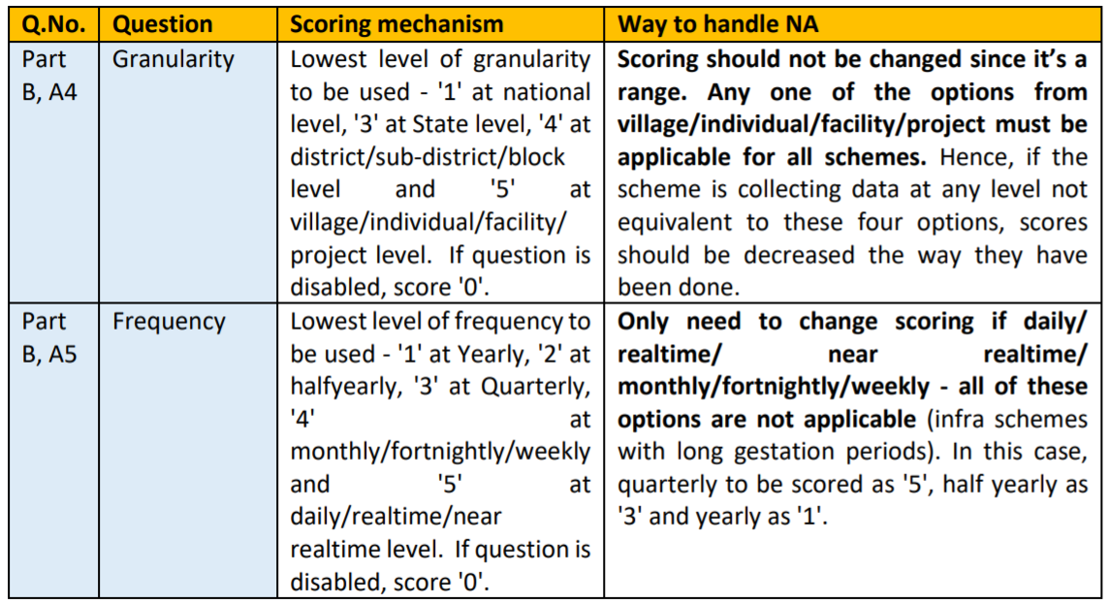
Special Cases Scoring

Slide 56
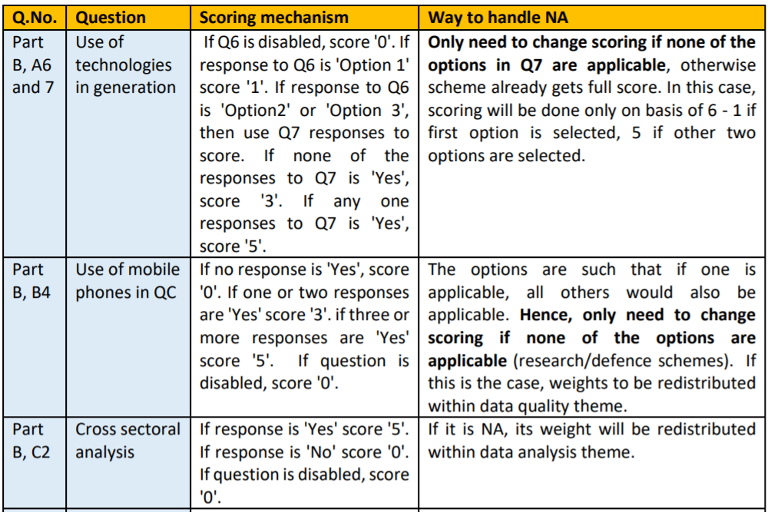

Slide 57
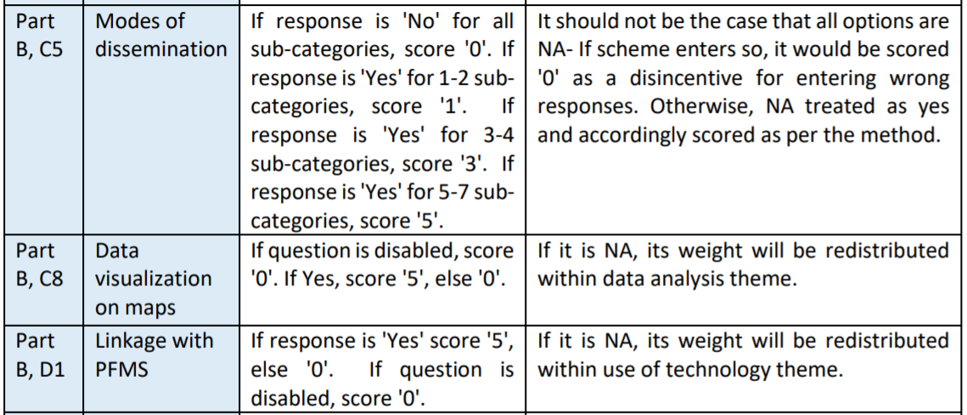

Slide 58
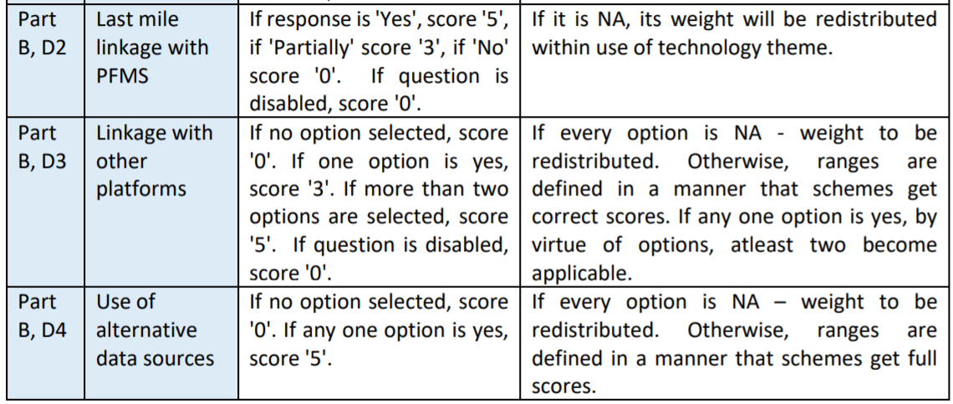

Slide 59
