Slide 1
Outcome Budgeting in Odisha The Experience So Far
Finance Department
Government of Odisha
22nd June, 2022

Slide 2
Outcome Budget
What?
Method of budgeting that measures the progress of each Department and what has been done with allocated budget
Basically a progress card on what various Departments have done with the assigned budget
Why?
Focus confined to outlay
Public concerned with outcomes
One of the important elements of PFM is linking outlay to outcome
Finance Commissions’ emphasis on outcome oriented expenditure

Slide 3
Outcome Budget in Odisha: The Implementation Journey
Outcome Budget was introduced in the State in 2010-11 in 5 selected Departments i.e. Works, RD, WR, PR and W&CD on pilot basis
Extensive handholding support provided by FD
In 2011-12, OB was introduced in 8 more Departments i.e. S & ME, H & FW, Agriculture, F & ARD, H & UD, F & E, ST & SC and Energy

Slide 4
Outcome Budget in Odisha: The Implementation Journey
Subsequently, it was extended to 27 major spending departments covering important social, economic and infrastructure development sectors.
Programme Performance and Outcome Monitoring Unit established in 2013 under FD – mandated to provide support – preparation of the outcome budget, training on outcome budget, monitoring the progress of preparation, troubleshooting/facilitation with concerned authorities as and when needed
Design, development and roll out of pilot online outcome budget preparation in 2021-2022

Slide 5
Process till Online Outcome Budgeting
Prepared manually till Online Outcome Budgeting which was time consuming
Duplication of work- activities carried out by the Departments are also indicated in their Annual Activity Report .
Monitoring of achievements against the targets set in OB was done in the next financial year.

Slide 6
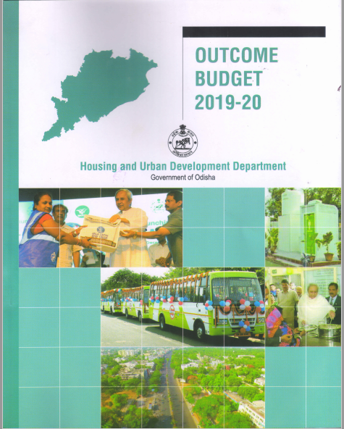
Outcome Budget before Online System

Slide 7
Why Online OB?
To avoid duplication of work
Save time and paper work
As a part of 5T initiative of the Government and PFM reforms.

Slide 8
Advantages of OB in Budget Execution Technique Automation (BETA)
Can be prepared in less time as compared to manual mode.
Schemes and outlays are auto-populated
Green initiatives
Ensure concurrent monitoring and course correction
Will act as storehouse of data
Can be part of budget making process

Slide 9
Online Module in BETA
Guidelines for preparation of online OB in BETA along with user manual was issued
27 major spending Departments were required to prepare online OB mandatorily
A module has been developed in BETA
The BETA team and PPOMU have provided necessary technical guidance for the purpose
Necessary training and handholding support imparted

Slide 10
Monitoring Module in BETA
A monitoring module has also been developed in BETA
The Departments are required to enter their quarterly achievement (both financial & physical) against the target so fixed.
Guidelines along with user manual indicating detail process flow have been issued.

Slide 11
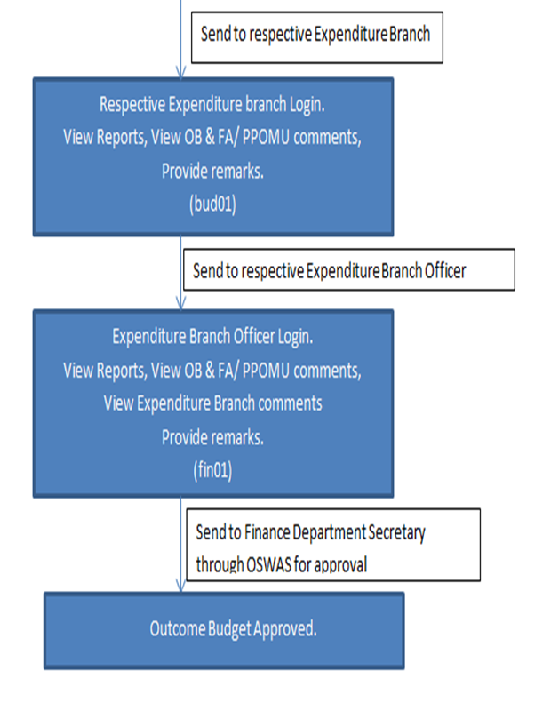
Process Flow

Slide 12
Major Stakeholders
Administrative Departments
Finance Department
PPOMU - knowledge partner

Slide 13
A Few Snapshots of Online OB in BETA

Slide 15
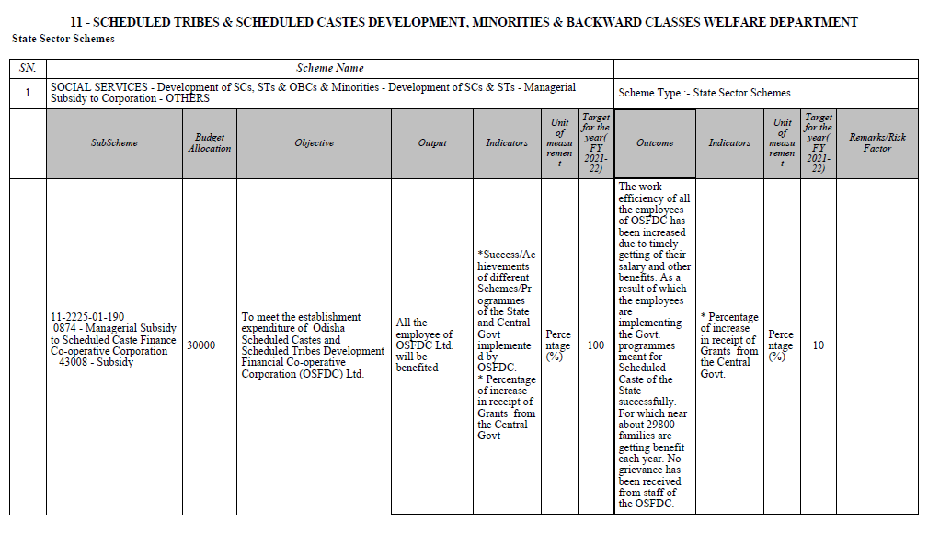
Final OB Document

Slide 16
Outcome Monitoring in BETA-Process flow
Administrative Department
FA Login.
Data entry of quarterly financial and physical progress
Send to Secretary (Administrative Department)
Secretary (Administrative Department) Login

Slide 17
Outcome Monitoring in BETA-Process flow
Review of Quarterly Financial and Physical Progress.
Approve if no modification is required
Review of Quarterly Financial and Physical Progress.
Return in case of modification required

Slide 18
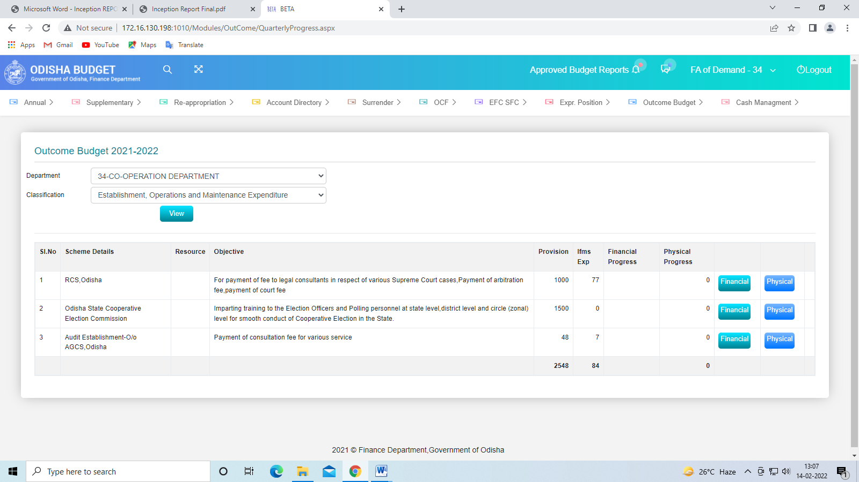
Snapshot of Online Monitoring in BETA

Slide 19
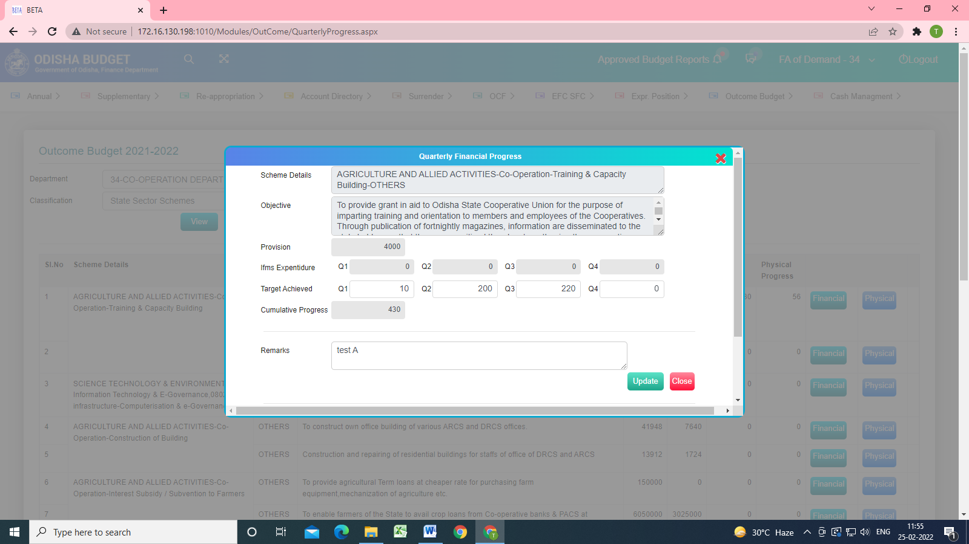

Slide 20
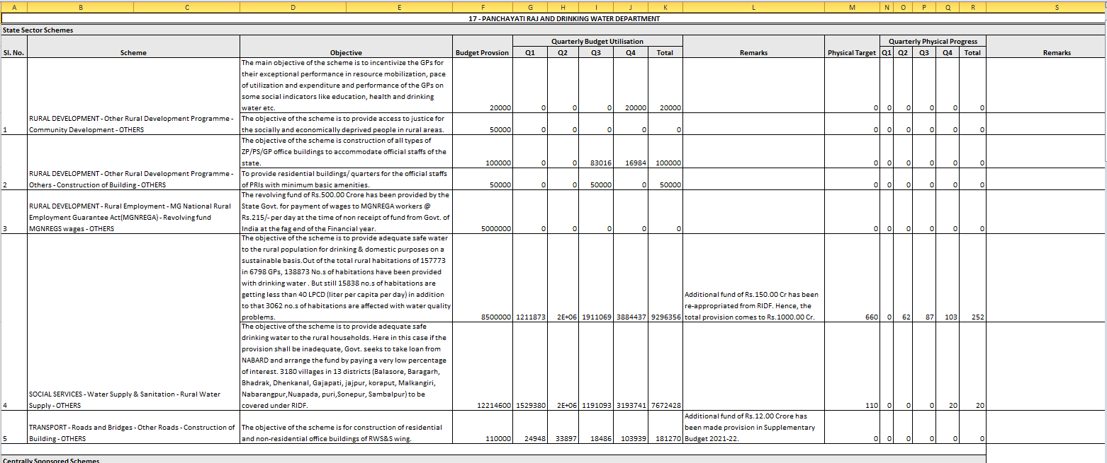
Online Monitoring Final

Slide 21
Challenges
Capacity Gaps
Understanding of concepts relating to outcome budget
Defining output and outcome indicators
Data flow from different levels to ensure quarterly online monitoring
Utilisation of OB in budget making process
Co-creation of an OB Ecosystem , particularly IT enabled data management system, that assists stated interested in utilising OB process

Slide 22
Way Forward
Full scale capacity building of the concerned officials at the administrative department level – creating a resource pool
Facilitating use of 2022-2023 outcome budget in budget making process of 2023-2024
Create online quarterly monitoring system at the administrative department level for regular flow of online information from implementation level
Collaborating in Co-creation of the OB Ecosystem

Slide 23
THANK YOU

